Slide 1
Bangkok Housing Price Prediction
For buyers and sellers

Slide 2

Problems
Do you ever have a problem with housing price
when trying move to a new home ?
Housing price in Bangkok is normally fluctuated due to many factors, some factors are considered to be positive for the price,
but is that always true ?
Notes:
Try to aid this problem whoever you are, buyer or seller

Slide 3
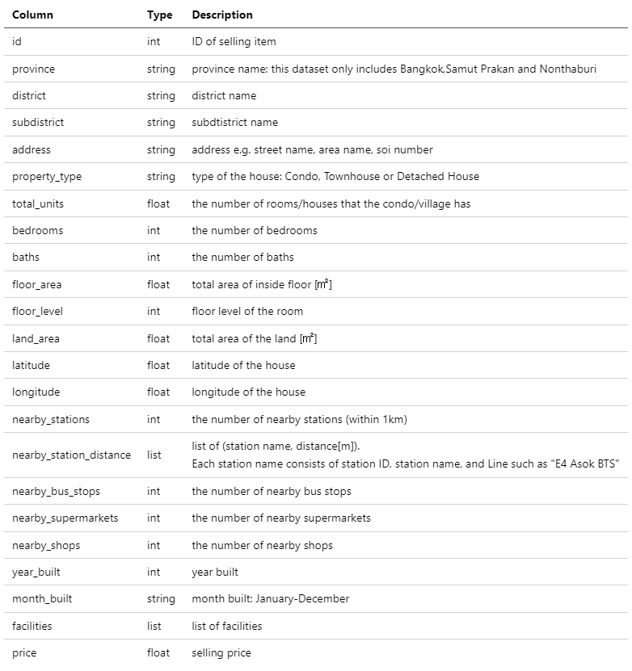
The data: Bangkok Housing Price
Notes:
By using this data to predict housing price
The data consists of many factors that might affect the housing price

Slide 4
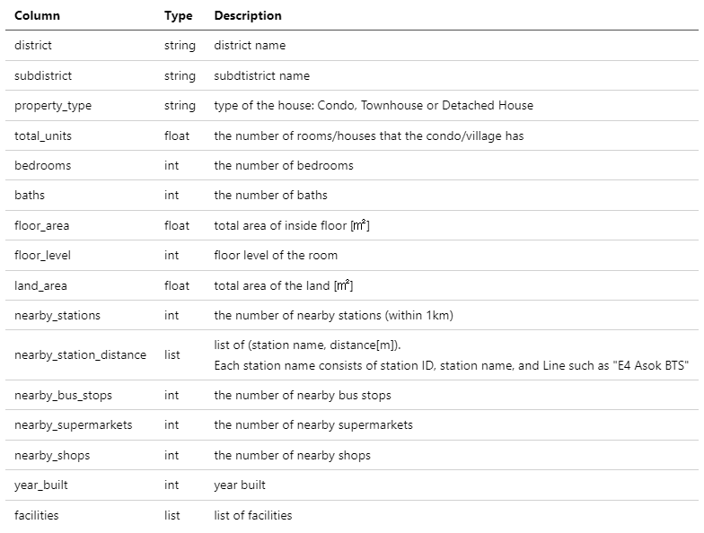
Considering the information …
Useless
Id
Month built
Address
Redundant
Province
Latitude
Longitude
Useless
Id
Month built
Address
Redundant
Province
Latitude
Longitude
Notes:
After exploring the data, relationship is not that strong, so first try to pick features from basic knowledge
From this point, if your aren’t into technical, you can just ignore and wait for the result

Slide 5
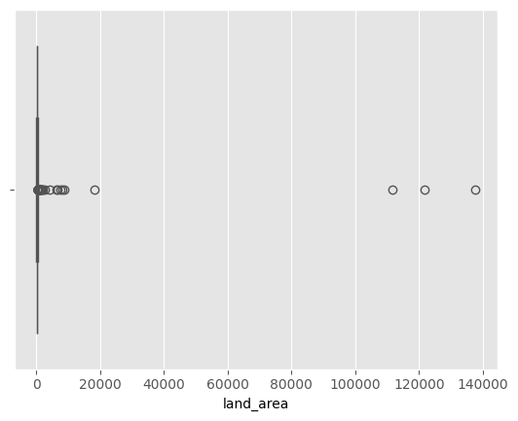
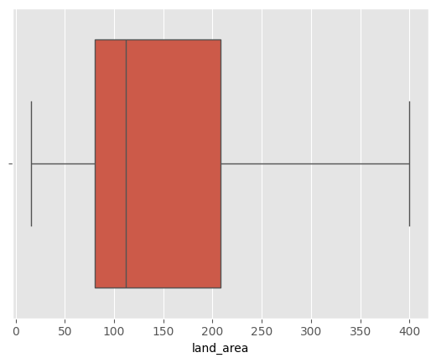
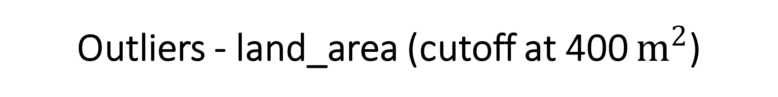
Outliers - land_area (cutoff at 400 $m^{2}$)

Slide 6
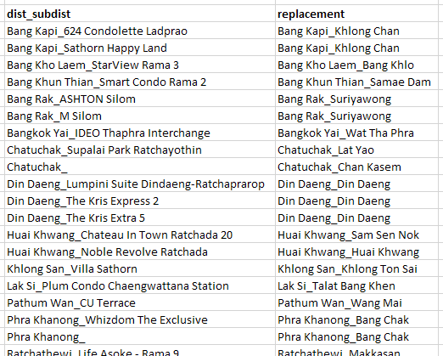
Value corrections
There are some incorrect values in subdistrict that need to be replaced.

Slide 7
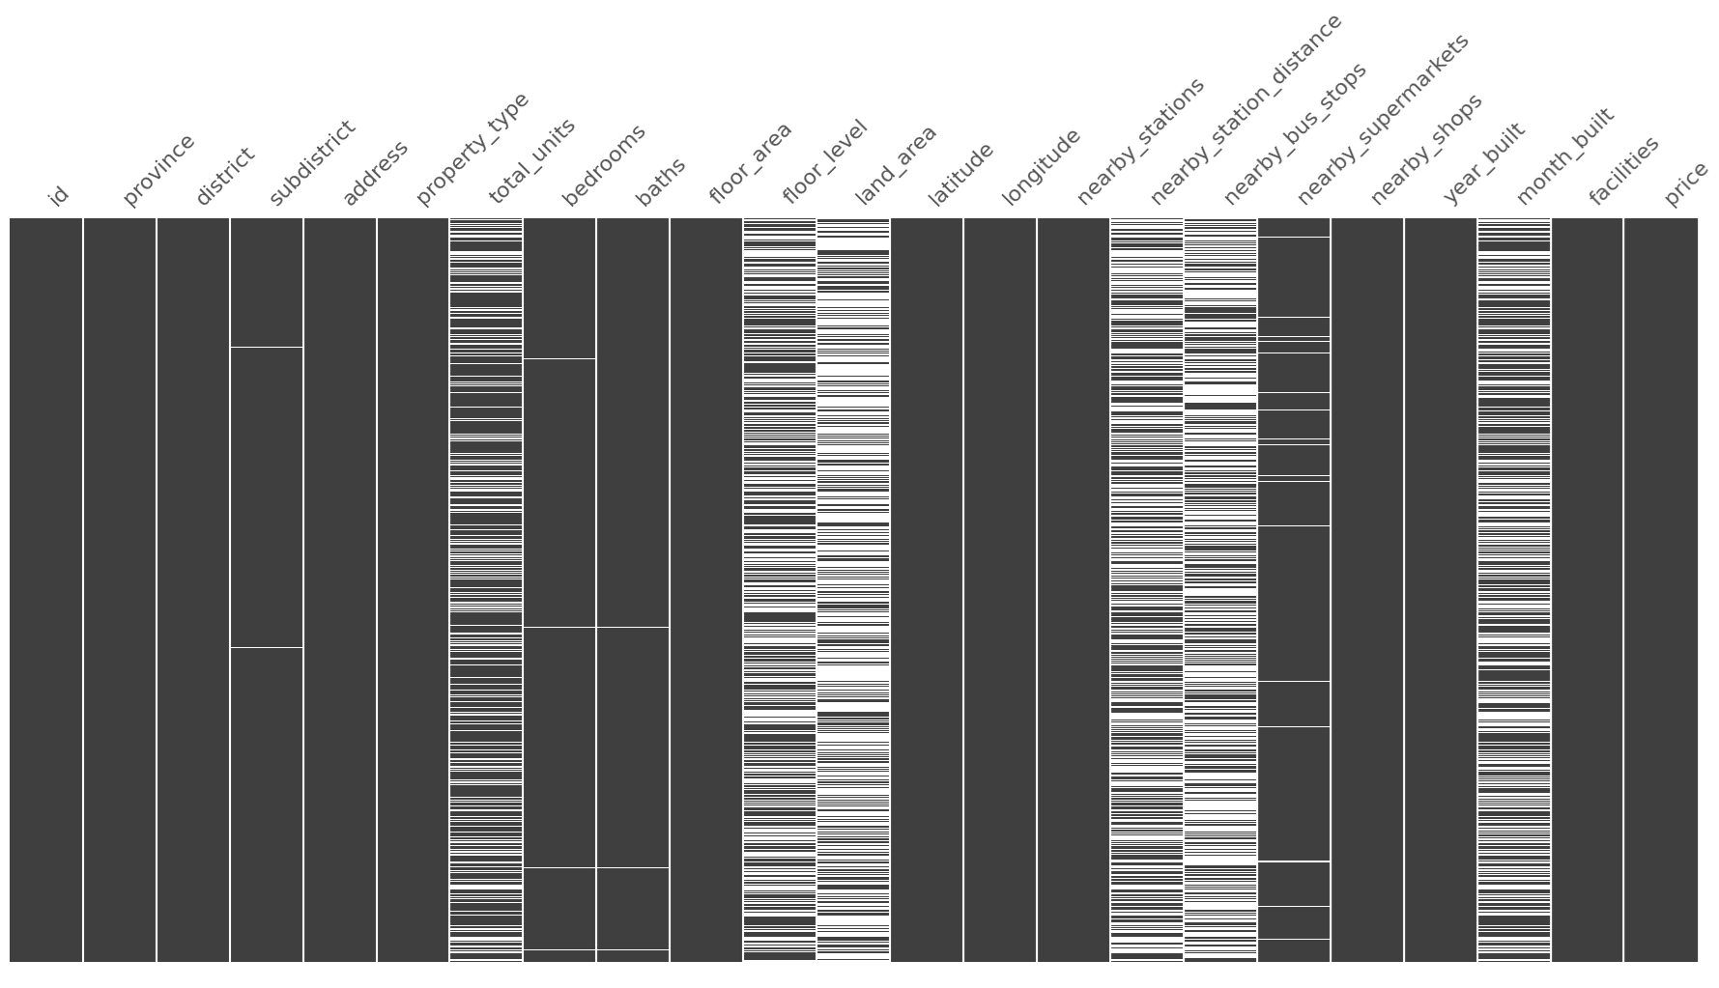
A lot of missing data
Notes:
As there is a lot of missing data, various techniques is used to ensure that model training data is enough for better prediction accuracy,
along with some transformations on the original data.
Some column with fewer missing value, those value can be removed
Red columns are what will be used, so it’s need to be replace with some value using various techniques (called imputation, being imputed)

Slide 8
A lot of missing data
KNN-imputed with missing indicator
* There are 0 in year_built, replace it with empty value and then impute
Notes:
Year_built = 0 has to be replaced with empty value first to be able to use KNN-imputation function
(one kind of technique, finding the rows in the table that are the most nearly identical to this row and use their values in this column as a guideline to filling the missing one)

Slide 9
A lot of missing data
KNN-imputed with missing indicator
Mean-imputed with missing indicator
Notes:
Land area missing a lot for Condo (property type), but the mean-imputed product the better result
Mean-imputed -> replace with its average value

Slide 10
A lot of missing data
KNN-imputed with missing indicator
Mean-imputed with missing indicator
Custom transformation + scaling
Notes:
Blue need to use custom transformation, as the missing value means there is no nearby station which can be possible
Will be explained more later

Slide 11
A lot of missing data
KNN-imputed with missing indicator
Mean-imputed with missing indicator
Custom transformation + scaling
Then, drop the rest of missing value
except “month_built” because it is not used
96.17% of
the original data
Notes:
Some column with fewer missing value, those value can be removed
Red columns are what will be used, so it’s need to be imputed
Blue need to use custom transformation, as the missing value means there is no nearby station which can be possible
14271 -> 13725 (96.17%)

Slide 12
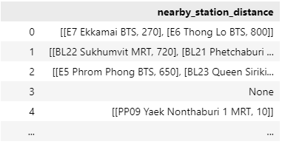
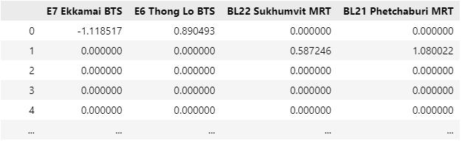
For nearby_station_distance
Custom transformation + scaling

Slide 13
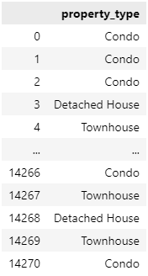
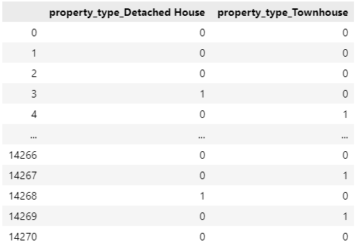
Dummified
Because prediction technique needs all data to be numbers …
Notes:
As the modeling technique needs all data to be numbers,
Some of columns need to be changed to number instead using method called dummified

Slide 14
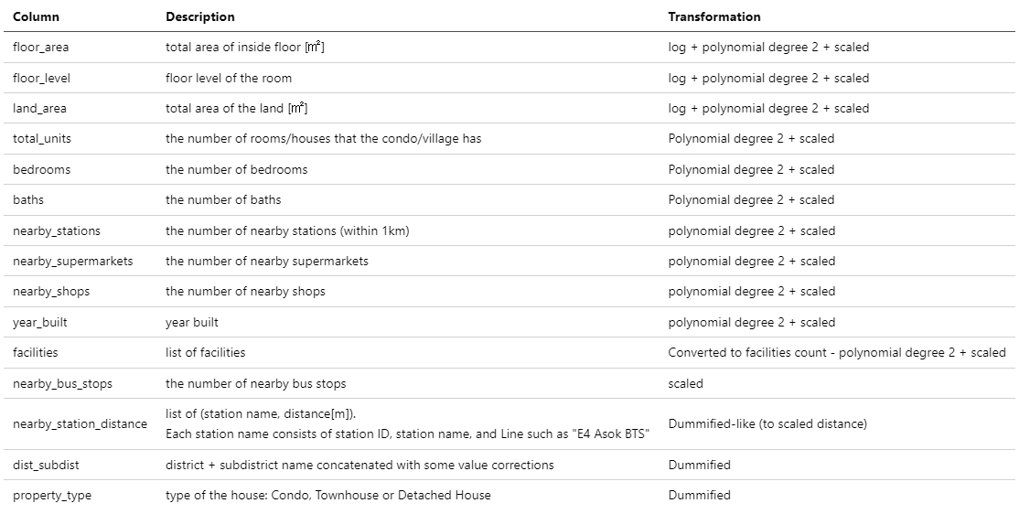
Other transformations & summary
* Total of 438 features
Notes:
Every column from floor_area to nearby_bus_stops is also normalized (scaled to the same unit)

Slide 15
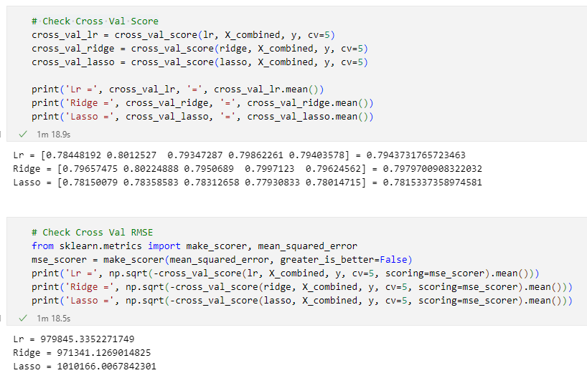
Model Validation and Selection
Notes:
Experimenting with many models, comparing the score
Also run some train/test split

Slide 16
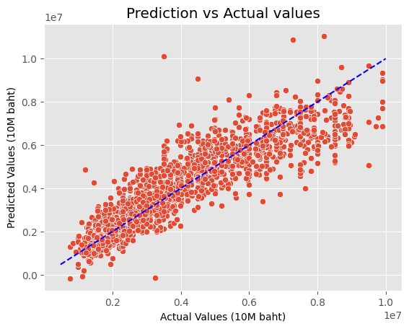
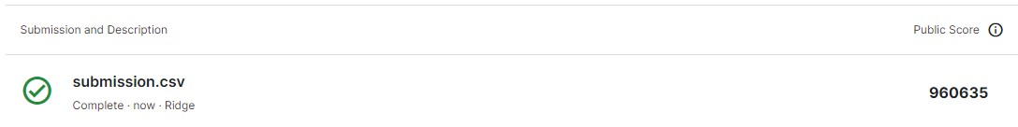
Result
Prediction model that
Can explain 79.8% of data
The average error of 971K THB
approximately
Notes:
From the limitation of given data

Slide 17
Other findings
The following factors are significantly affect housing price positively.
Floor area
Number of bathrooms
Number of nearby stations (within 1km)
Total area of the land
Year built
Number of bedrooms

Slide 18
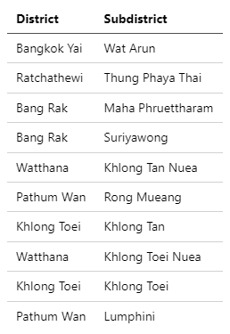
Other findings
Top 10 district/subdistrict that will have
higher housing price according to the model.

Slide 19
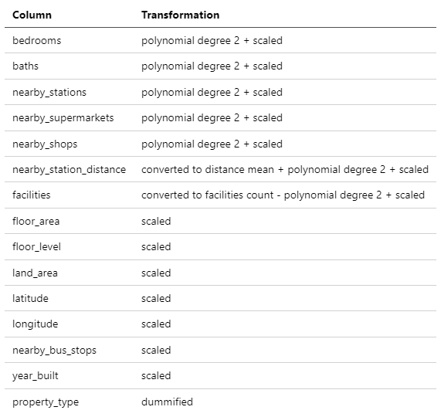
Extra
XGBoost model with ~85% score
Average error ~771K
Total of 49 features

